Slide 1
Week 13a
COMPUTATIONAL MATHEMATICS
1D Optimization Method
Wednesday, 3 June 2020

Slide 2
Reference
Kisualaas, Jann. (2013). Numerical Methods in Engineering with Python 3. Cambridge University Press.
Johansson, Robert. (2015). Chapter 5. Equation Solving. Numerical Python: A Practical Techniques Approach for Industry, Apress.
Chapra, S. C., and Raymond P. Canale. (2010). Numerical methods for engineers, Sixth edition, McGraw Hill.
Kaw, A. (n.d.). Numerical Methods. Retrieved March 20, 2020, from https://nm.mathforcollege.com/

Slide 3
Mathematical Background
Objective: Maximize or Minimize f(x)
subject to
x = {x₁, x₂, …, x_{n}}
f(x): objective function
d_{i}(x): inequality constraints
e_{i}(x): equality constraints
a_{i} and b_{i} are constants

Slide 4
Classification of Optimization Problems
If f(x) and the constraints are linear, we have linear programming.
e.g.: Maximize x + y subject to
3x + 4y ≤ 2
y ≤ 5
If f(x) is quadratic and the constraints are linear, we have quadratic programming.
If f(x) is not linear or quadratic and/or the constraints are nonlinear, we have nonlinear programming.

Slide 5
Examples
Product Mix: Determine how many products of each type to assemble from certain parts to maximize profits while not exceeding available parts inventory
Machine Allocation: Allocate production of a product to different machines, with different capacities, startup cost and operating cost, to meet production target at minimum cost
Workforce Composition: Decide how many employees to retrain, hire and fire to meet changing workforce composition requirements while minimizing costs or employee turnover
Notes:
https://www.solver.com/examples-optimization-problems

Slide 6
More Examples
Transportation Model: Determine how many products to ship from each factory to each warehouse, or from each factory to each warehouse and direct to each end customer, to minimize shipping cost while meeting warehouse demands and not exceeding factory supplies
Partial Loading: Decide which sizes or types of products to load into a vehicle, given its size limits, to best meet demand or to minimize wasted space
Media Planning: Decide how much advertising to purchase in different media to minimize total cost while achieving a target level of reach or frequency

Slide 7
Classification of Optimization Problems
When constraints (equations marked with *) are included, we have a constrained optimization problem.
Otherwise, we have an unconstrained optimization problem.

Slide 8
Optimization Methods
One-Dimensional Unconstrained Optimization
Newton's Method
Golden-Section Search
Quadratic Interpolation
Multi-Dimensional Unconstrained Optimization
Non-gradient or direct methods
Gradient methods
Linear Programming (Constrained)
Graphical Solution
Simplex Method

Slide 9
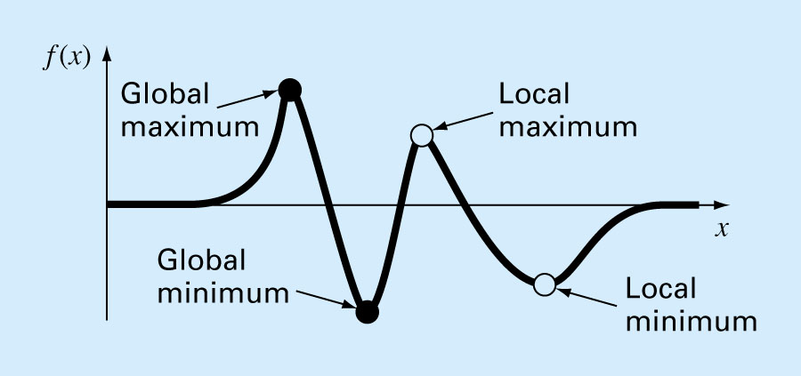
Global and Local Optima
A function is said to be multimodal on a given interval if there are more than one minimum/maximum point in the interval.

Slide 10
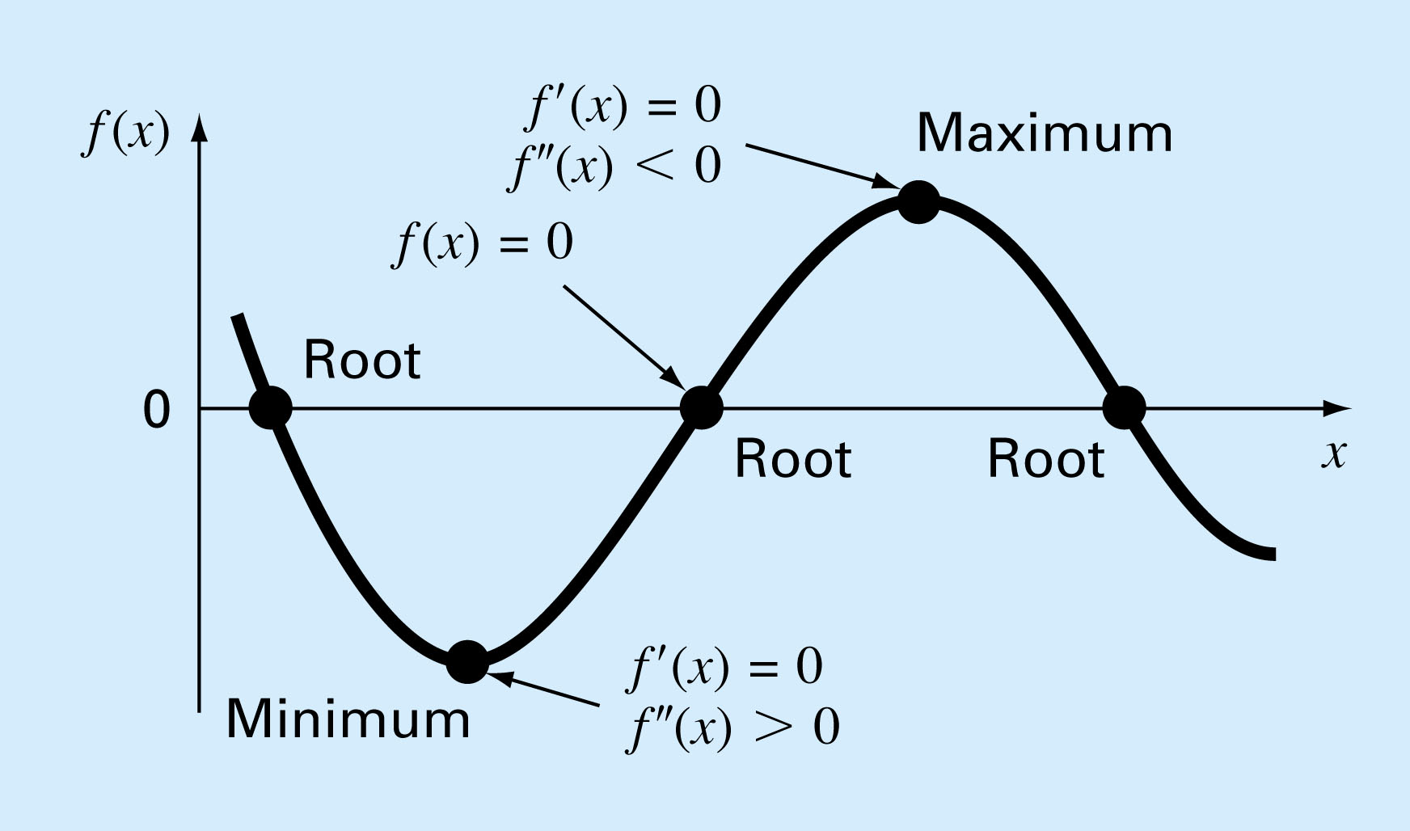
Characteristics of Optima
To find the optima, we can find the zeroes of f'(x).
Notes:
First Derivative:
if the first derivative is negative to the left of the critical point, and positive to the right of it, it is a relative minimum. If the first derivative test finds the first derivative is positive to the left of the critical point, and negative to the right of it, the critical point is a relative maximum.
Second Derivative:
The second derivative test is useful when trying to find a relative maximum or minimum if a function has a first derivative that is zero at a certain point. Since the first derivative test fails at this point, the point is an inflection point. The second derivative test relies on the sign of the second derivative at that point. If it is positive, the point is a relative minimum, and if it is negative, the point is a relative maximum.

Slide 11
Newton’s Method
Let g(x) = f'(x)
Thus the zeroes of g(x) is the optima of f(x), the same as finding the root of g(x)
Substituting g(x) into the updating formula of Newton-Rahpson method, we have
Note: Other root finding methods will also work.

Slide 12
Example
.
2
2
θ
2
θ
The cross-sectional area A of a gutter with equal base and edge length of 2 is given by
Find the angle θ which maximizes the cross-sectional area of the gutter.

Slide 13
Solution
The function to be maximized is
Iteration 1: Use as the initial estimate of the solution

Slide 14
Solution Cont.
Iteration 2:
Summary of iterations
Iteration | θ
1 | 0.7854 | 2.8284 | -10.8284 | 1.0466 | 5.1962
2 | 1.0466 | 0.0062 | -10.3959 | 1.0472 | 5.1962
3 | 1.0472 | 1.06E-06 | -10.3923 | 1.0472 | 5.1962
4 | 1.0472 | 3.06E-14 | -10.3923 | 1.0472 | 5.1962
5 | 1.0472 | 1.3322E-15 | -10.3923 | 1.0472 | 5.1962
Remember that the actual solution to the problem is at 60 degrees or 1.0472 radians.

Slide 15
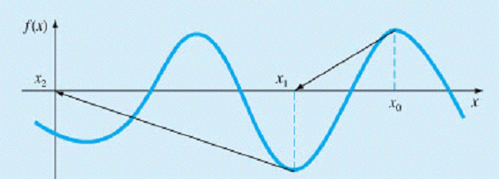
Newton’s Method
Shortcomings
Need to derive f'(x) and f"(x).
May diverge
May "jump" to another solution far away
Advantages
Fast convergent rate near solution
Hybrid approach: Use bracketing method to find an approximation near the solution, then switch to Newton's method.

Slide 16
Bracketing Method
f(x)
x_{l} x_{u} x
Suppose f(x) is unimodal on the interval [x_{l}, x_{u}]. That is, there is only one local maxima in [x_{l}, x_{u}].
Objective: Gradually narrowing down the interval by eliminating the sub-interval that does not contain the maxima.

Slide 17
Bracketing Method
x_{l} x_{a} x_{b} x_{u} x
x_{l} x_{a} x_{b} x_{u} x
Let x_{a} and x_{b} be two points in (x_{l}, x_{u}) where x_{a} < x_{b}.
If f(x_{a}) > f(x_{b}), then the maximum point will not reside in the interval [x_{b}, x_{u}] and as a result we can eliminate the portion toward the right of x_{b}.
In other words, in the next iteration we can make x_{b} the new x_{u}

Slide 18
Bracketing Method
x_{l} x_{a} x_{b} x_{u} x
x_{l} x_{a} x_{b} x_{u} x
Let x_{a} and x_{b} be two points in (x_{l}, x_{u}) where x_{a} < x_{b}.
If f(x_{a}) > f(x_{b}), then the maximum point will not reside in the interval [x_{b}, x_{u}] and as a result we can eliminate the portion toward the right of x_{b}.
In other words, in the next iteration we can make x_{b} the new x_{u}
How we choose the next values of x_{a} and x_{b}?

Slide 19
Generic Bracketing Method (Pseudocode)
// xl, xu: Lower and upper bounds of the interval
// es: Acceptable relative error
function BracketingMax(xl, xu, es) {
do {
prev_optimal = optimal;
Select xa and xb s.t. xl <= xa < xb <= xu;
if (f(xa) > f(xb))
xu = xb;
else
xl = xa;
optimal = max(f(xa), f(xb));
ea = abs((max – prev_max) / max);
} while (ea < es);
return max;
}

Slide 20
Bracketing Method
How would you suggest we select x_{a} and x_{b} (with the objective to minimize computation)?
Eliminate as much interval as possible in each iteration
Set x_{a} and x_{b} close to the center so that we can halve the interval in each iteration
Drawbacks: function evaluation is usually a costly operation.
Minimize the number of function evaluations
Select x_{a} and x_{b} such that one of them can be reused in the next iteration (so that we only need to evaluate f(x) once in each iteration).
How should we select such points?

Slide 21
Current iteration
Objective:
l₁
l₁
l_{o}
If we can calculate x_{a} and x_{b} based on the ratio R w.r.t. the current interval length in each iteration, then we can reuse one of x_{a} and x_{b} in the next iteraton.
In this example, x_{a} is reused as x'_{b} in the next iteration so in the next iteration we only need to evaluate f(x'_{a}).
x_{l} x_{a} x_{b} x_{u}
Next iteration
l'₁
l'₁
l'_{o}
x'_{l} x'_{a} x'_{b} x'_{u}
x_{l} x_{a} x_{b} x_{u}

Slide 22
Current iteration
l₁
l₁
l_{o}
x_{l} x_{a} x_{b} x_{u}
Next iteration
l'₁
l'₁
l'_{o}
x'_{l} x'_{a} x'_{b} x'_{u}
x_{l} x_{a} x_{b} x_{u}
Golden Ratio

Slide 23
Golden-Section Search
Starts with two initial guesses, x_{l} and x_{u}
Two interior points x_{a} and x_{b} are calculated based on the golden ratio as
In the first iteration, both x_{a} and x_{b} need to be calculated.
In subsequent iteration, x_{l} and x_{u} are updated accordingly and only one of the two interior points needs to be calculated. (The other one is inherited from the previous iteration.)

Slide 24
Golden-Section Search
In each iteration the interval is reduced to about 61.8% (Golden ratio) of its previous length.
After 10 iterations, the interval is shrunk to about (0.618)¹⁰ or 0.8% of its initial length.
After 20 iterations, the interval is shrunk to about (0.618)²⁰ or 0.0066%.

Slide 25
Example
.
2
2
θ
2
θ
The cross-sectional area A of a gutter with equal base and edge length of 2 is given by
Find the angle θ which maximizes the cross-sectional area of the gutter. Using an initial interval of find the solution after 2 iterations. Use an initial .

Slide 26
Solution
The function to be maximized is
Iteration 1: Given the values for the boundaries of
we can calculate the initial intermediate points as follows:
f₁
f₂
X₁=?
X_{l}=X₂
X₂=X₁
X_{u}
X_{l}
X₂
X₁
X_{u}

Slide 27
Solution Cont
To check the stopping criteria the difference between and is calculated to be

Slide 28
Solution Cont
Iteration 2
X_{l}
X₂
X₁
X_{u}

Slide 29
Theoretical Solution and Convergence
Iteration | x_{l} | x_{u} | x₁ | x₂ | f(x₁) | f(x₂) | ε
1 | 0.0000 | 1.5714 | 0.9712 | 0.6002 | 5.1657 | 4.1238 | 1.5714
2 | 0.6002 | 1.5714 | 1.2005 | 0.9712 | 5.0784 | 5.1657 | 0.9712
3 | 0.6002 | 1.2005 | 0.9712 | 0.8295 | 5.1657 | 4.9426 | 0.6002
4 | 0.8295 | 1.2005 | 1.0588 | 0.9712 | 5.1955 | 5.1657 | 0.3710
5 | 0.9712 | 1.2005 | 1.1129 | 1.0588 | 5.1740 | 5.1955 | 0.2293
6 | 0.9712 | 1.1129 | 1.0588 | 1.0253 | 5.1955 | 5.1937 | 0.1417
7 | 1.0253 | 1.1129 | 1.0794 | 1.0588 | 5.1908 | 5.1955 | 0.0876
8 | 1.0253 | 1.0794 | 1.0588 | 1.0460 | 5.1955 | 5.1961 | 0.0541
9 | 1.0253 | 1.0588 | 1.0460 | 1.0381 | 5.1961 | 5.1957 | 0.0334
The theoretically optimal solution to the problem happens at exactly 60 degrees which is 1.0472 radians and gives a maximum cross-sectional area of 5.1962.

Slide 30
Quadratic Interpolation
Optima of g(x)
Optima of f(x)
f(x)
x₀ x₁ x₃ x₂ x
Idea:
(i) Approximate f(x) using a quadratic function g(x) = ax²+bx+c
(ii) Optima of f(x) ≈ Optima of g(x)

Slide 31
Quadratic Interpolation
Shape near optima typically appears like a parabola. We can approximate the original function f(x) using a quadratic function g(x) = ax² + bx + c.
At the optimum point of g(x), g'(x) = 2ax + b = 0.
Let x₃ be the optimum point, then x₃ = -b/2a.
How to compute b and a?
2 points => unique straight line (1st-order polynomial)
3 points => unique parabola (2nd-order polynomial)
So, we need to pick three points that surround the optima.
Let these points be x₀, x₁, x₂ such that x₀ < x₁ < x₂

Slide 32
Quadratic Interpolation
a and b can be obtained by solving the system of linear equations
Substitute a and b into x₃ = -b/2a

Slide 33
Quadratic Interpolation
The process can be repeated to improve the approximation.
Next step, decide which sub-interval to discard
Since f(x₃) > f(x₁)
if x₃ > x₁, discard the interval toward the left of x₁
i.e., Set x₀ = x₁ and x₁ = x₃
if x₃ < x₁, discard the interval toward the right of x₁
i.e., Set x₂ = x₁ and x₁ = x₃
Calculate x₃ based on the new x₀, x₁, x₂

Slide 34
Quadratic Interpolation
Optima of g(x)
Optima of f(x)
f(x)
x₀ x₁ x₃ x₂ x
x₃ > x₁
Optima of g(x)
Optima of f(x)
f(x)
x₀ x₁ x₂ x

Slide 35
Summary
Basics
Minimize f(x) = Maximize -f(x)
If f'(x) exists, then to find the optima of f(x), we can find the zero of f'(x).
Beware of inflection points of f(x)
Bracketing methods
Golden-Section Search and Quadratic Interpolation
How to select points and discard intervals

